Slide 1
One Nation, One Conversation
Notes:
Today I’m going to talk to you all about a problem we have in South Africa, and how we at Aweza are trying to use innovative digital technology to solve this issue.
Before I jump right into the details, I’m going to paint the picture for you by telling you a story.

Slide 2
Bonjour! Sanibonani! Molweni! Ndaa! Dumelang! Ahee! Lothjani! Hello! Dagsê!

Slide 3
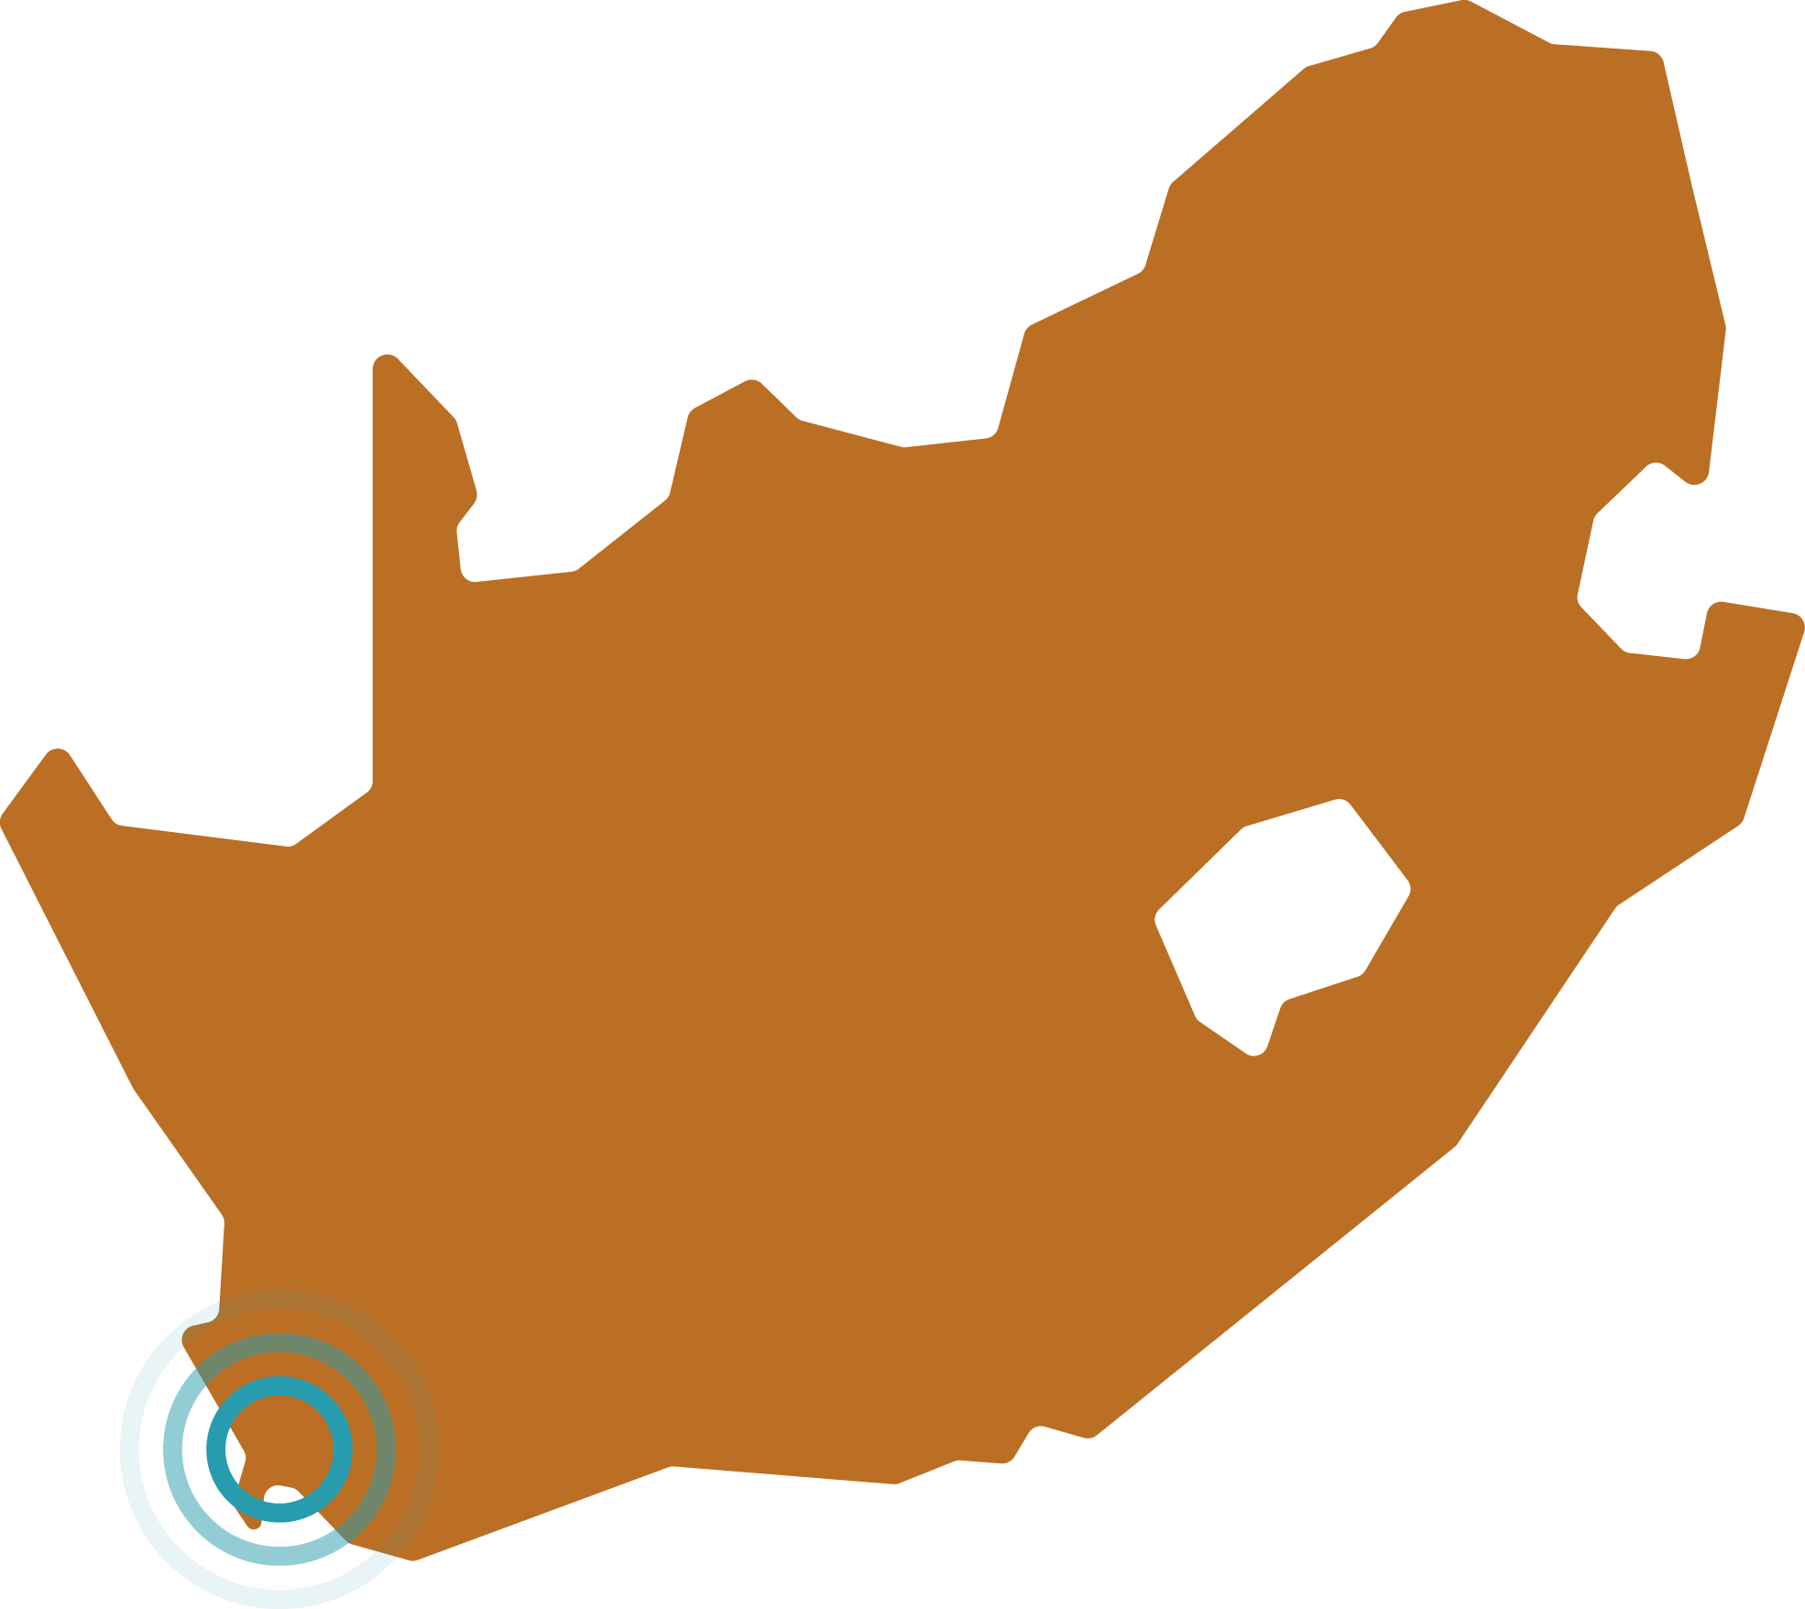
Glenn Stein
Founder - Aweza
Notes:
Today I’m going to talk to you all about a problem we have in South Africa, and how we at Aweza are trying to use innovative digital technology to solve this issue.
Before I jump right into the details, I’m going to paint the picture for you by telling you a story.

Slide 4
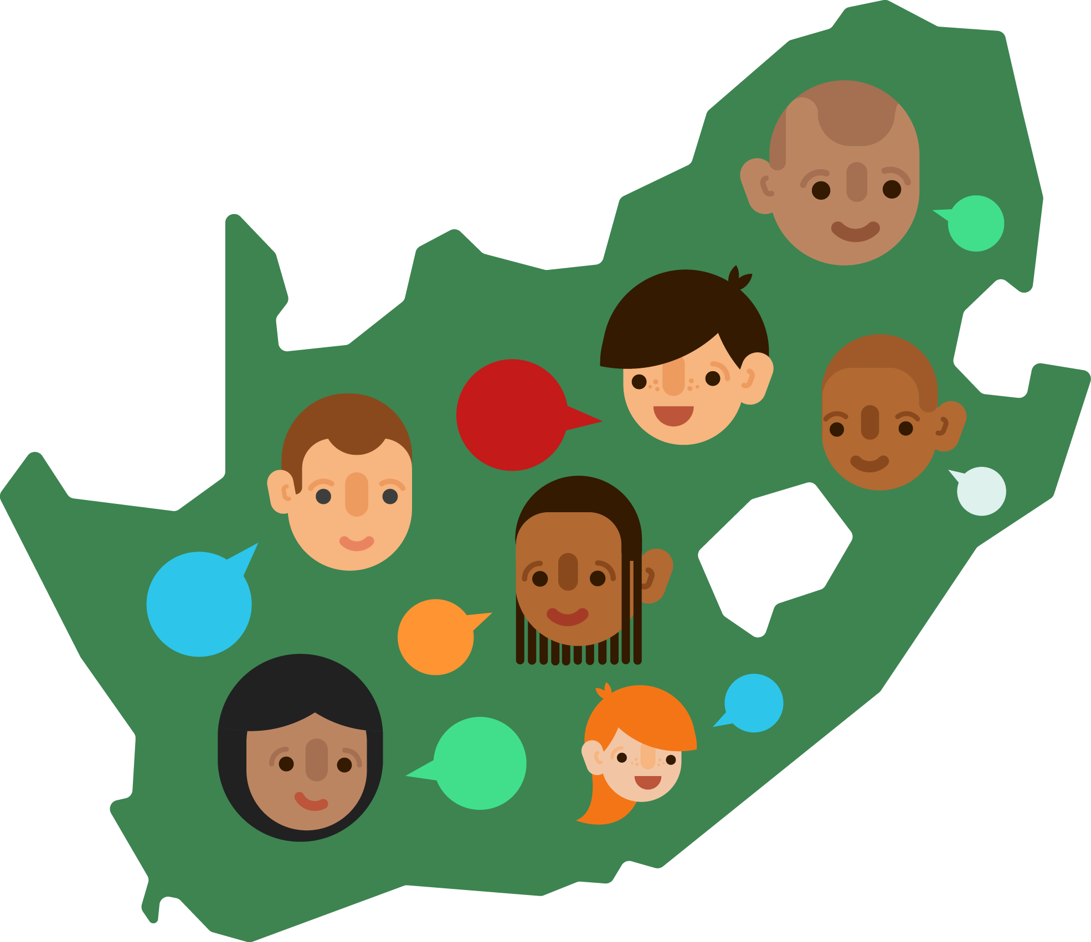
Notes:
Today I’m going to talk to you all about a problem we have in South Africa, and how we at Aweza are trying to use innovative digital technology to solve this issue.
Before I jump right into the details, I’m going to paint the picture for you by telling you a story.

Slide 5
“When you speak to a man in a language he understands, you speak to his mind. When you speak to a man in his mother tongue, you speak to his heart.”

Slide 6
“When you speak to a man in a language he understands, you speak to his mind. When you speak to a man in his mother tongue, you speak to his heart.”
Nelson Mandela

Slide 7
Awê + ZA
“Hello / Yes / Thank you / Cool”
South Africa
#OneNationOneConversation

Slide 9
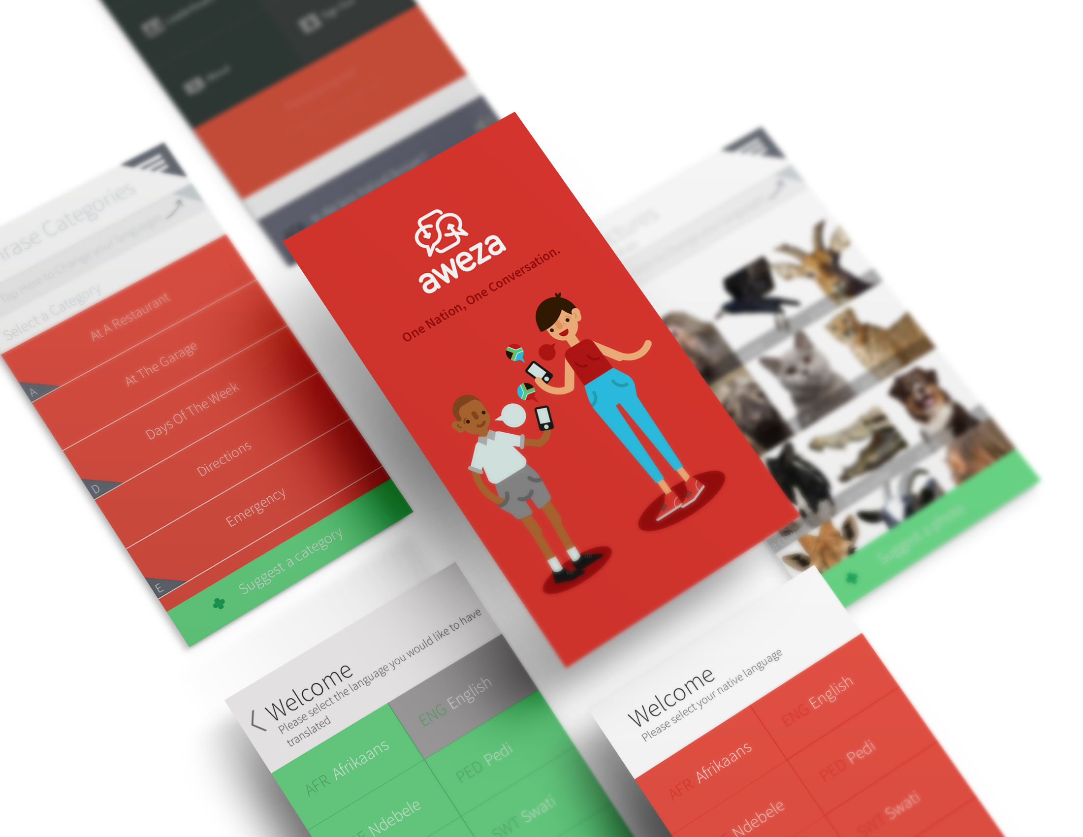

Slide 10
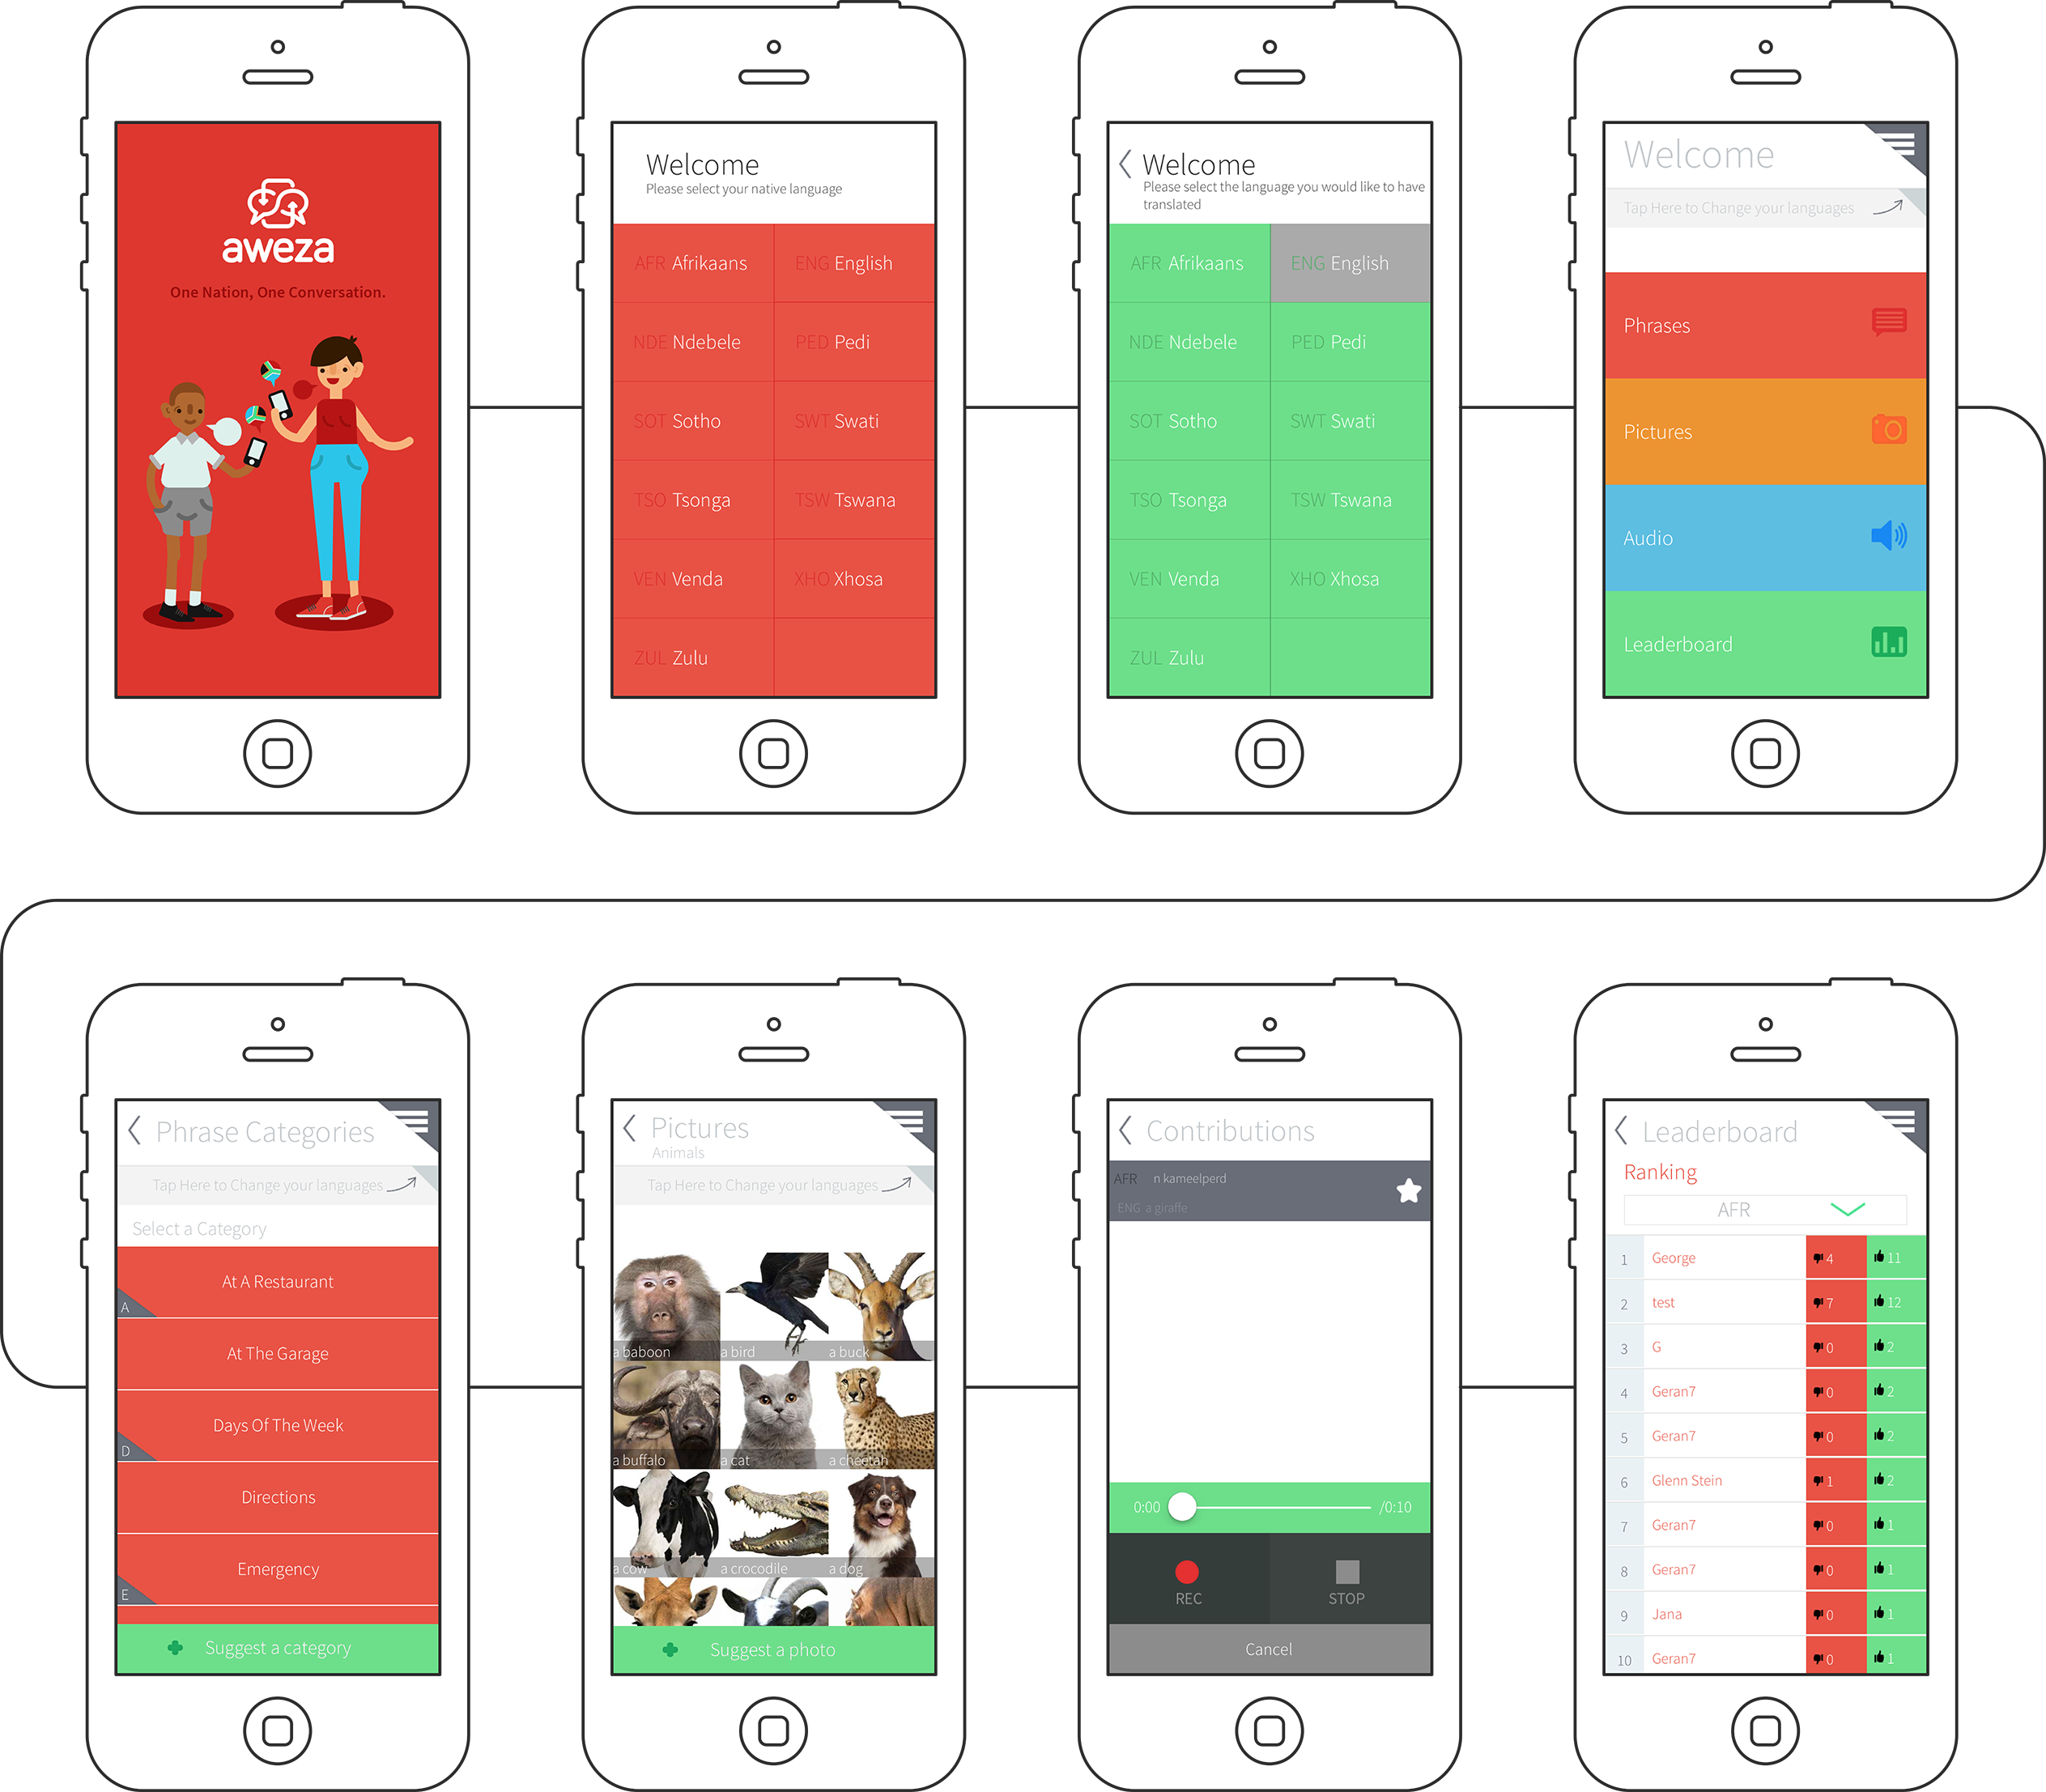

Slide 11
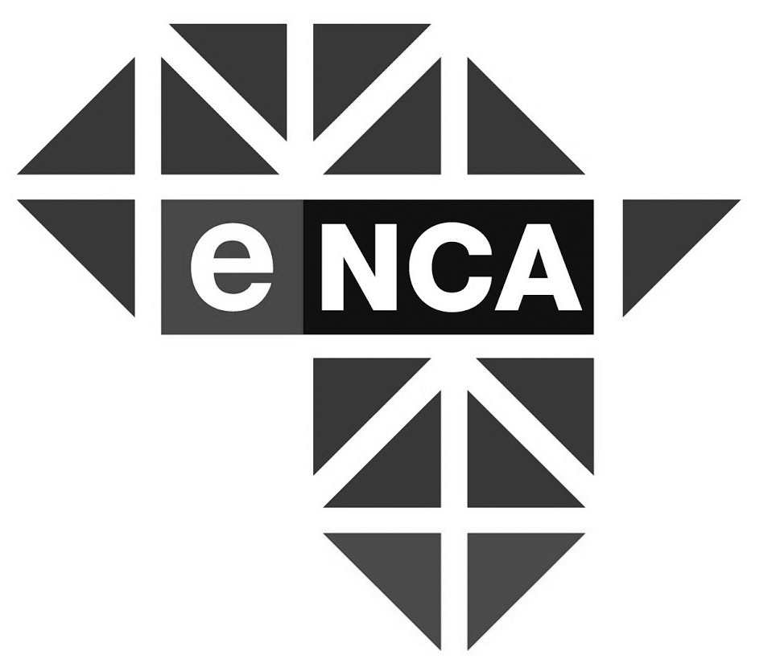

Slide 13
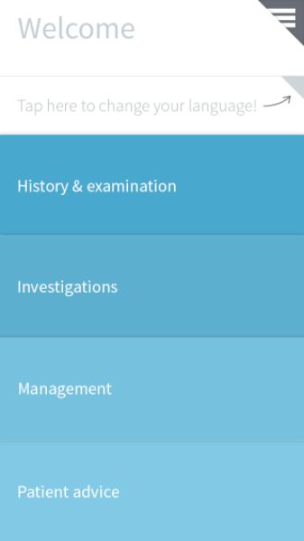
#OneNationOneConversation

Slide 14
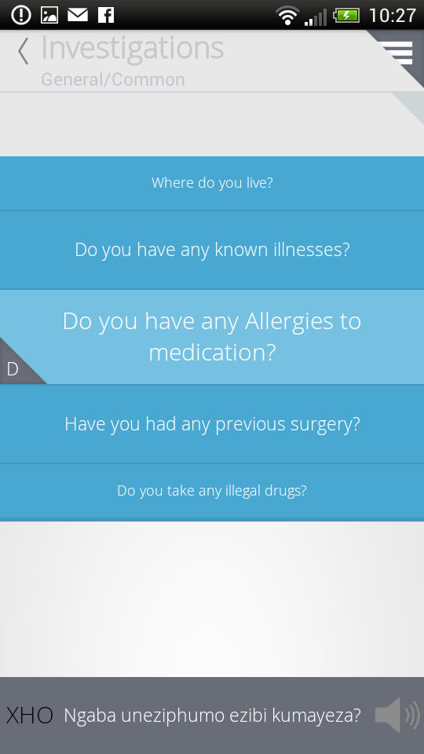

Slide 15
How is South Africa affected?
Poor education system = mass youth unemployment
63%
- The Economist, 2016

Slide 16
How is South Africa affected?
(CRIME) + (lack of professionals) = struggling economy
#OneNationOneConversation

Slide 17
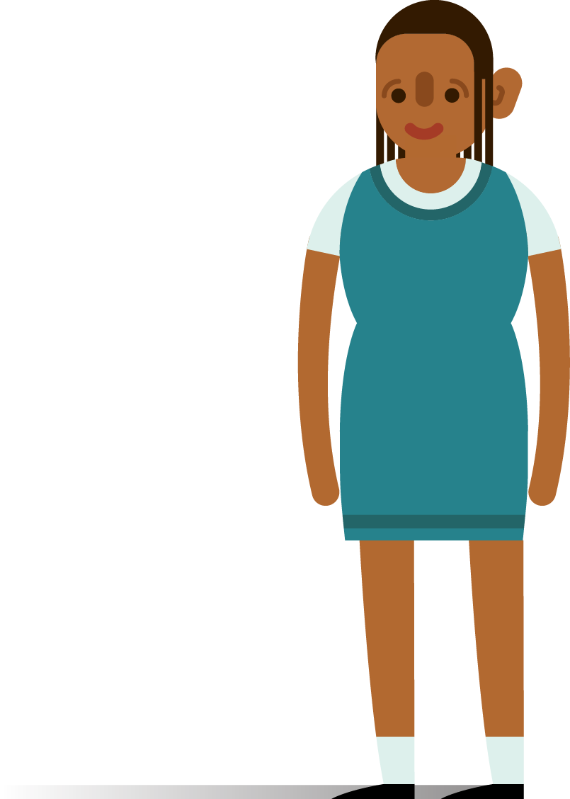
Meet Thandi
#OneNationOneConversation
Notes:
Thandi the rural school child (± 2.45m)
————————
Thandi is 12 years old and lives in [reigon, province].
[Description of province, most spoken language and metric passrate]. Thandi would like to become an engineer one day. [move this to when she’s older]
Up until grade 6 she is taught in her mother tongue, which is also the mother tongue of the teacher. Thandi is a smart child and under these circumstances Thandi excels, but when she reaches grade 7 the language she gets taught in, by SA Law, changes to english [insert contextual info relating to Eng in South Africa].
Although Thandi is very determined to excel at school, she now has to learn in a language that she is not very comfortable with, and to make matters worse her teacher is not much more comfortable with English than Thandi is.
This is where a big problem that we are facing in South Africa starts.
With Thandi’s lack of exposure to English and her teachers lack of experience teaching in english, she is might be able to move through the syllabus grasping around 40% of the content. As you imagine, this greatly impacts on her ability to excel. So what happens now? Well at the end of Thandi’s school career, if she was lucky enough to make it that far into her primary education, she has to write a national exam, which students at the vast majority of schools in South Africa also have to write.
Now for example in the mathematics paper, While a first language english speaking student in Cape Town understands a question and is busy focusing their time and energy on calculating the answer, Thandi focusing her time and energy on trying to understand what the actual is even asking her to do. In many cases she will answer incorrectly or eventually move on to the next question, with which she will very likely face the same problem. By the time that the exam writing period is over, she hasn’t even managed to finish all the answers as she was spending so much time trying to understand the questions, a task which is not accounted for by the educators who set the exams.
If you consider that this pattern is repeated throughout all the exams that Thandi writes, it becomes clear that Thandi would be considered lucky to pass her exams.

Slide 18
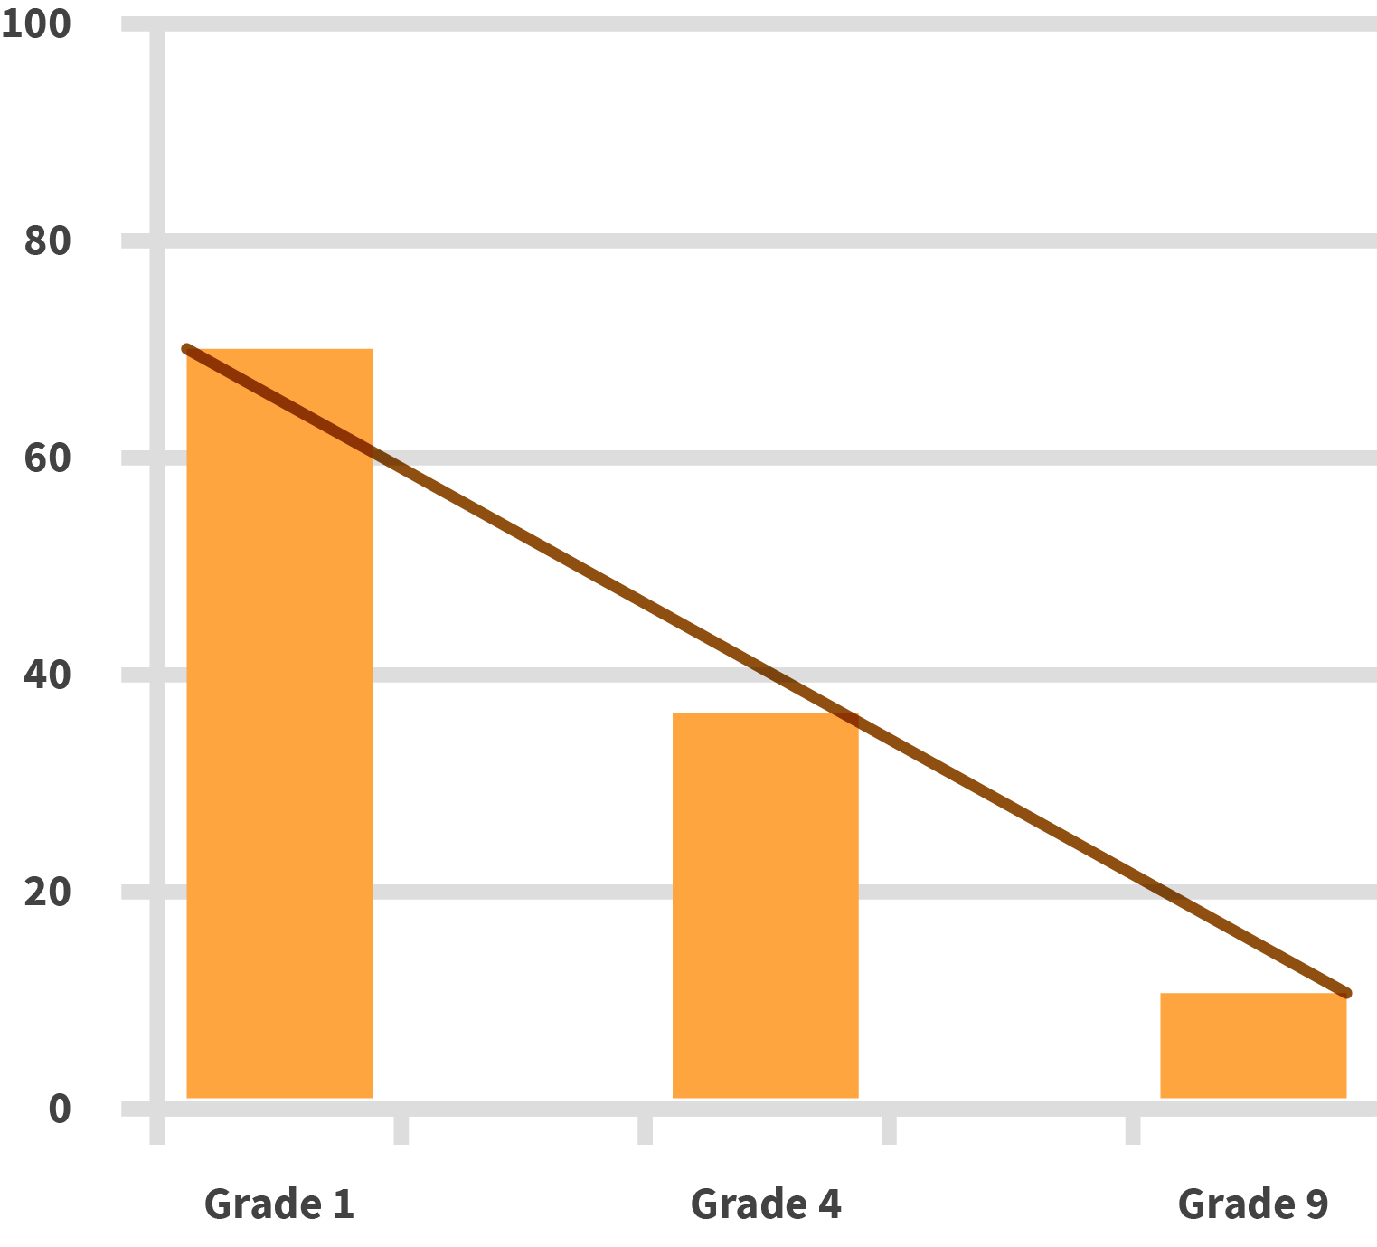
Mathematics average percentage marks
#OneNationOneConversation
Notes:
Thandi the rural school child (± 2.45m)
————————
Thandi is 12 years old and lives in [reigon, province].
[Description of province, most spoken language and metric passrate]. Thandi would like to become an engineer one day. [move this to when she’s older]
Up until grade 6 she is taught in her mother tongue, which is also the mother tongue of the teacher. Thandi is a smart child and under these circumstances Thandi excels, but when she reaches grade 7 the language she gets taught in, by SA Law, changes to english [insert contextual info relating to Eng in South Africa].
Although Thandi is very determined to excel at school, she now has to learn in a language that she is not very comfortable with, and to make matters worse her teacher is not much more comfortable with English than Thandi is.
This is where a big problem that we are facing in South Africa starts.
With Thandi’s lack of exposure to English and her teachers lack of experience teaching in english, she is might be able to move through the syllabus grasping around 40% of the content. As you imagine, this greatly impacts on her ability to excel. So what happens now? Well at the end of Thandi’s school career, if she was lucky enough to make it that far into her primary education, she has to write a national exam, which students at the vast majority of schools in South Africa also have to write.
Now for example in the mathematics paper, While a first language english speaking student in Cape Town understands a question and is busy focusing their time and energy on calculating the answer, Thandi focusing her time and energy on trying to understand what the actual is even asking her to do. In many cases she will answer incorrectly or eventually move on to the next question, with which she will very likely face the same problem. By the time that the exam writing period is over, she hasn’t even managed to finish all the answers as she was spending so much time trying to understand the questions, a task which is not accounted for by the educators who set the exams.
If you consider that this pattern is repeated throughout all the exams that Thandi writes, it becomes clear that Thandi would be considered lucky to pass her exams.

Slide 19
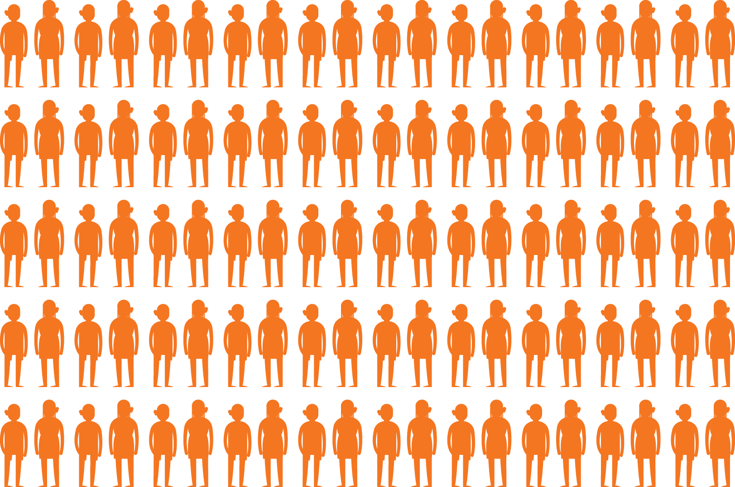

Slide 20
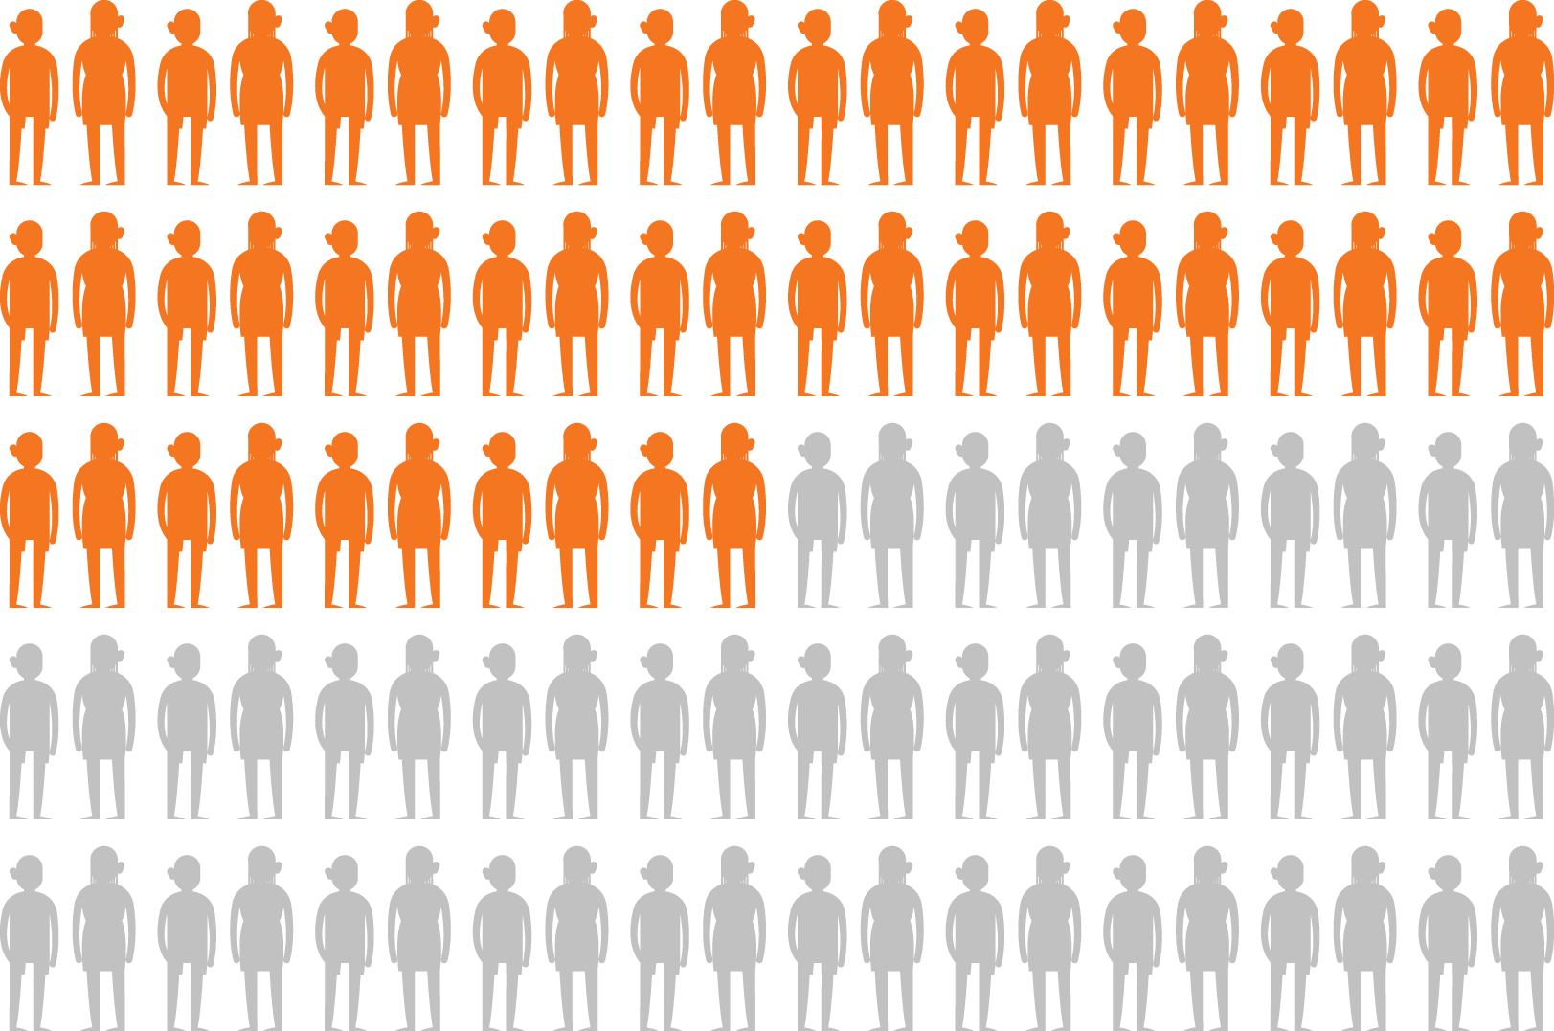

Slide 21
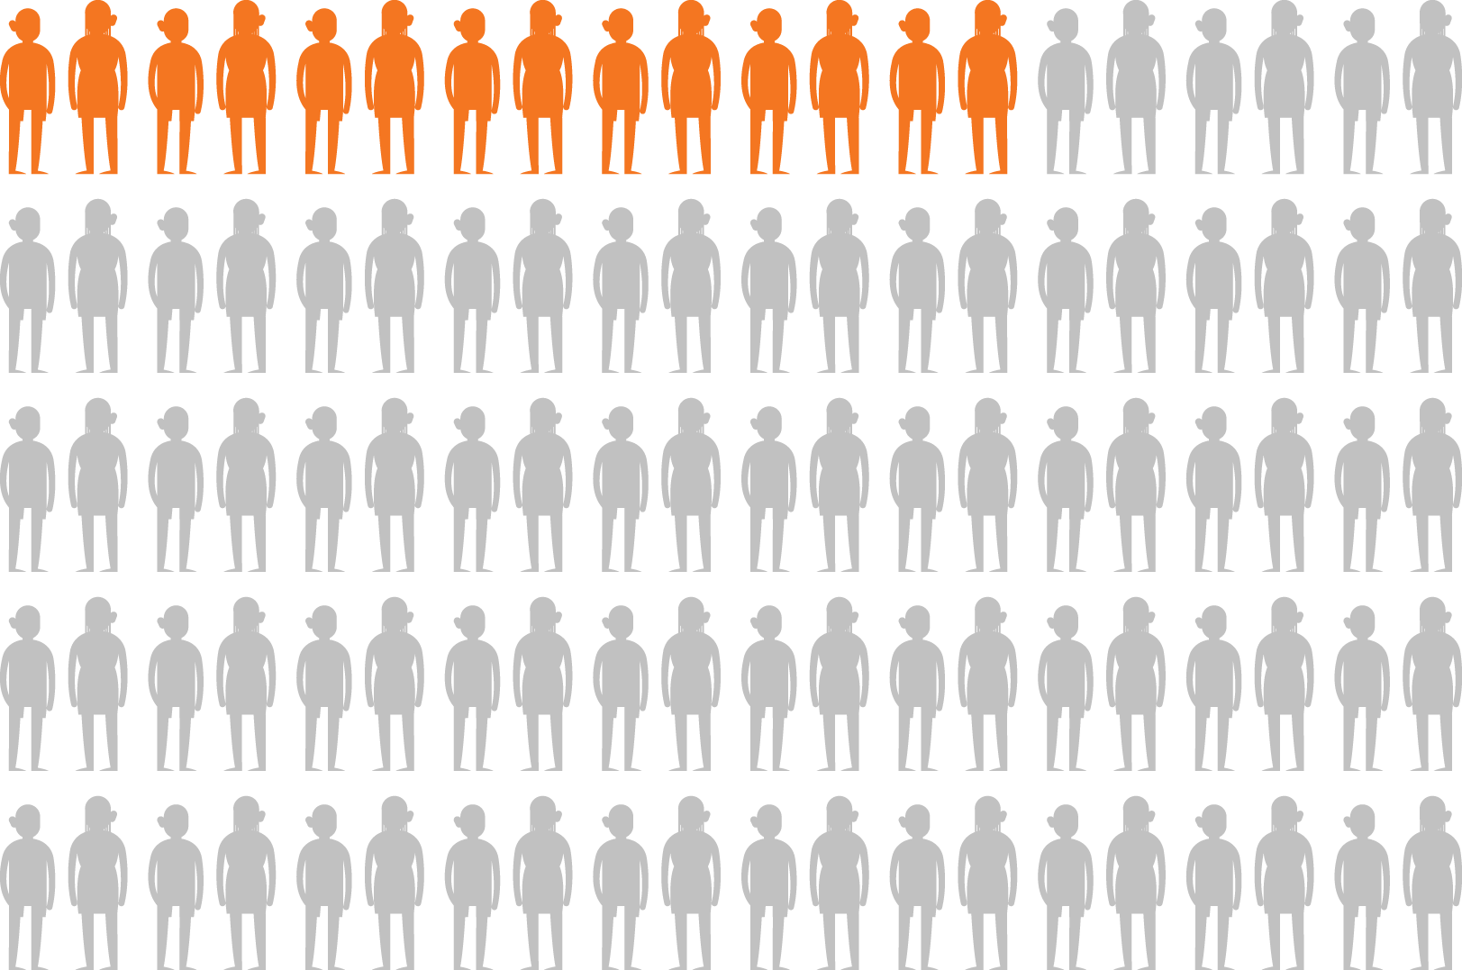

Slide 22
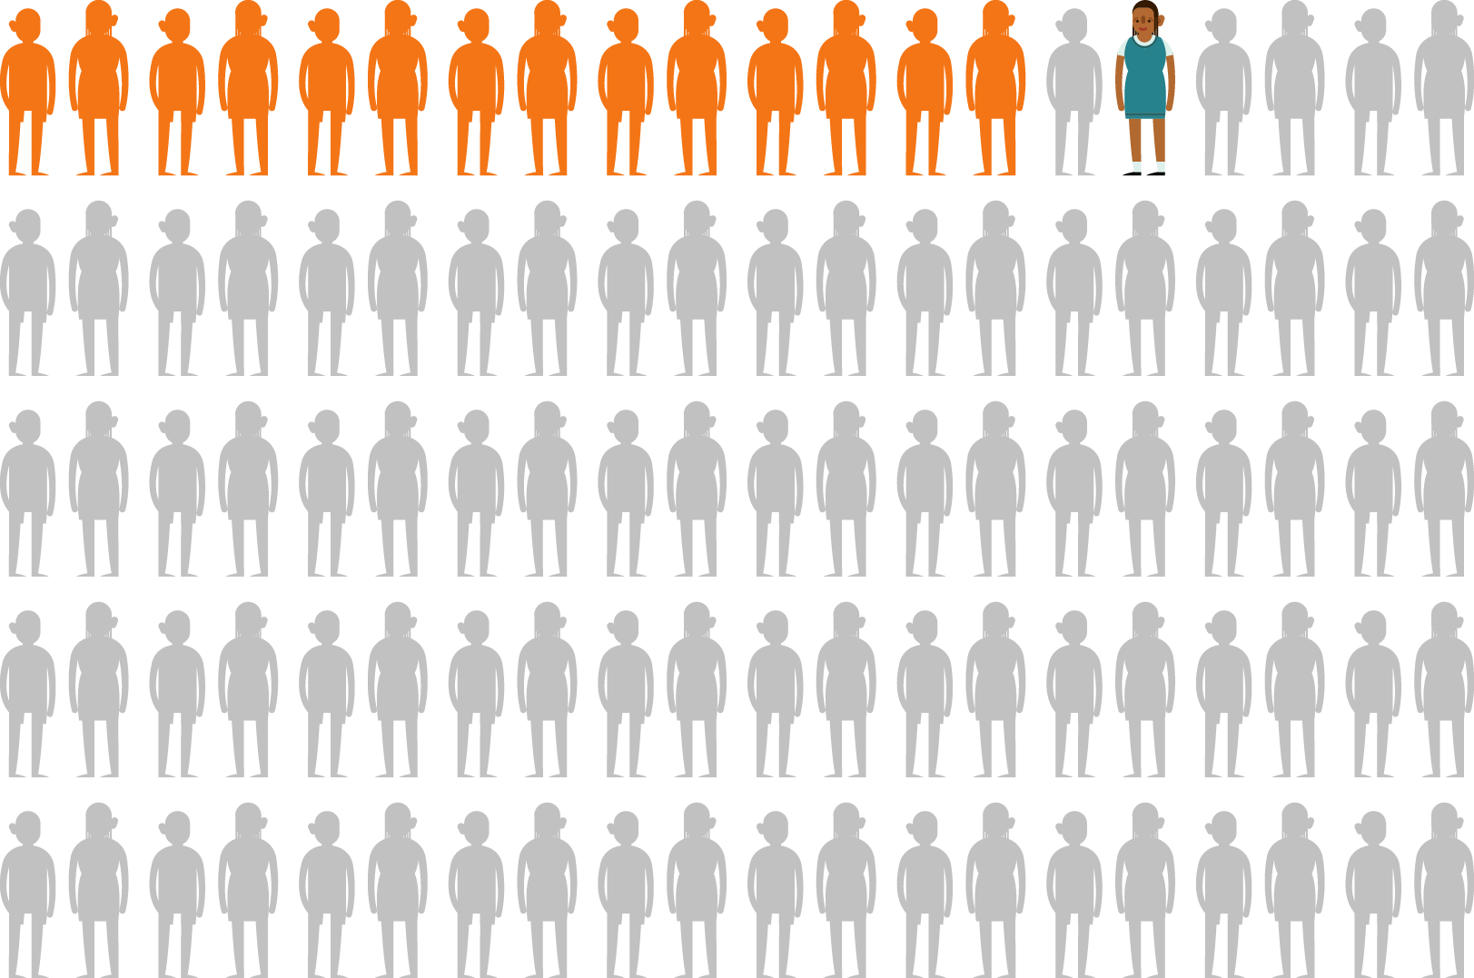

Slide 23
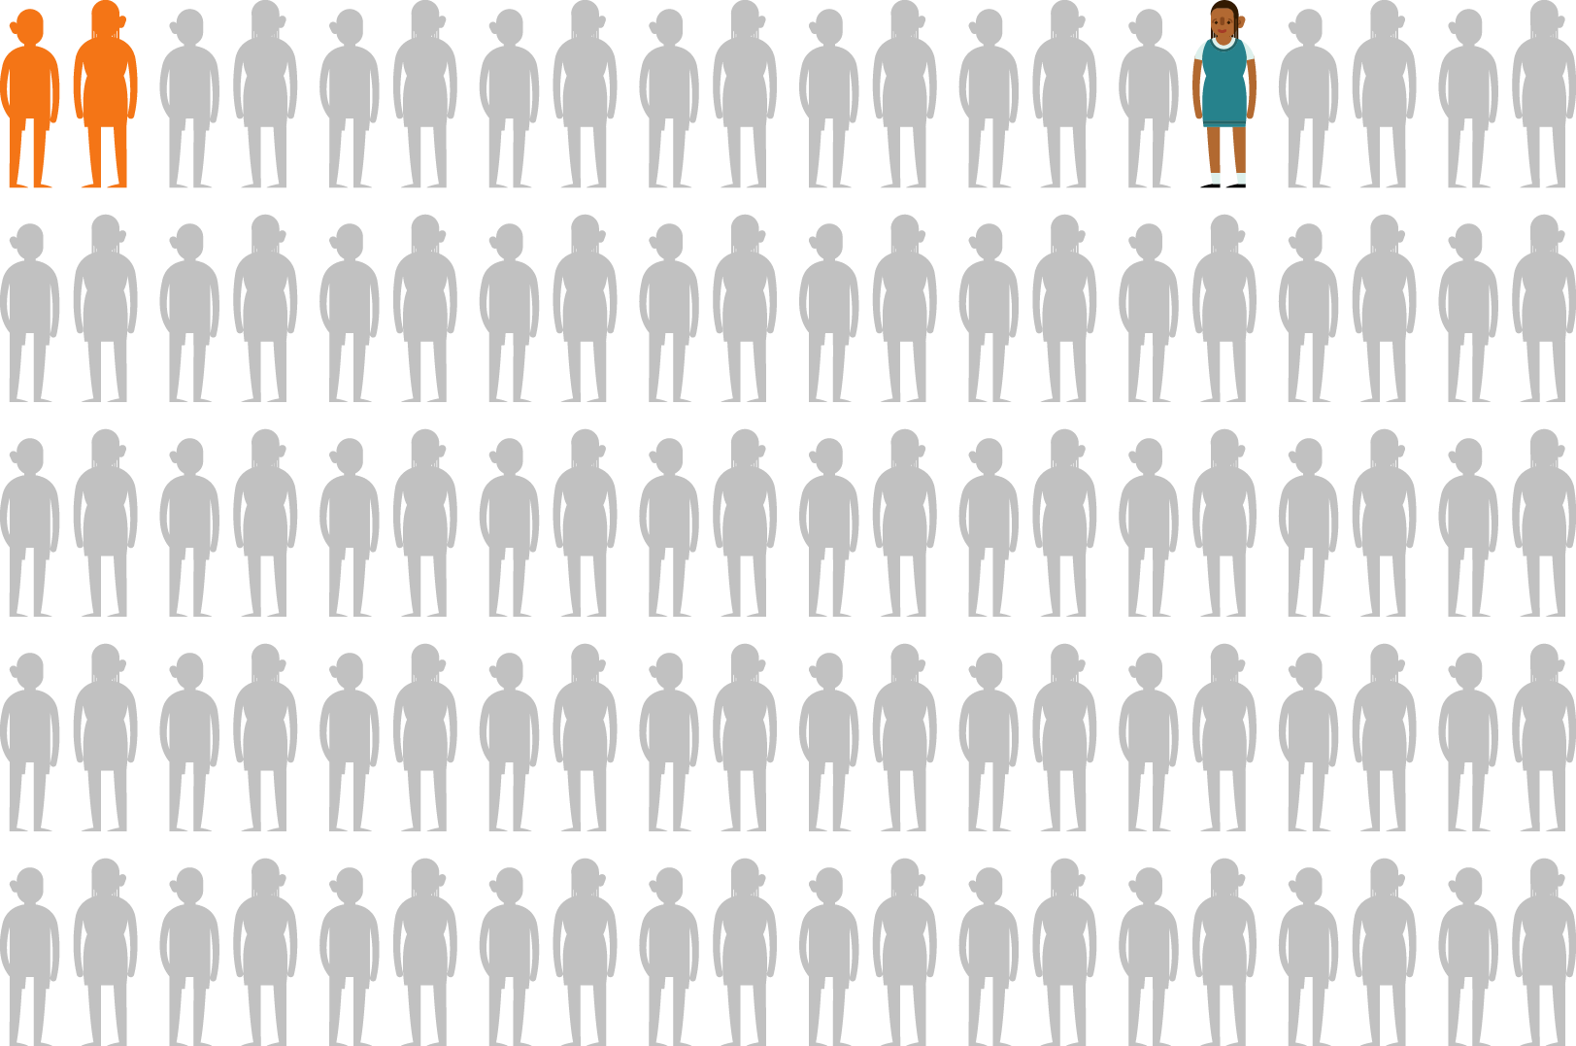

Slide 24
Driving forces
behind social & economic failure
Poor numeracy
Poor literacy
No textbooks
No teachers
#OneNationOneConversation

Slide 25
#OneNationOneConversation
Notes:
Thandi the rural school child (± 2.45m)
————————
Thandi is 12 years old and lives in [reigon, province].
[Description of province, most spoken language and metric passrate]. Thandi would like to become an engineer one day. [move this to when she’s older]
Up until grade 6 she is taught in her mother tongue, which is also the mother tongue of the teacher. Thandi is a smart child and under these circumstances Thandi excels, but when she reaches grade 7 the language she gets taught in, by SA Law, changes to english [insert contextual info relating to Eng in South Africa].
Although Thandi is very determined to excel at school, she now has to learn in a language that she is not very comfortable with, and to make matters worse her teacher is not much more comfortable with English than Thandi is.
This is where a big problem that we are facing in South Africa starts.
With Thandi’s lack of exposure to English and her teachers lack of experience teaching in english, she is might be able to move through the syllabus grasping around 40% of the content. As you imagine, this greatly impacts on her ability to excel. So what happens now? Well at the end of Thandi’s school career, if she was lucky enough to make it that far into her primary education, she has to write a national exam, which students at the vast majority of schools in South Africa also have to write.
Now for example in the mathematics paper, While a first language english speaking student in Cape Town understands a question and is busy focusing their time and energy on calculating the answer, Thandi focusing her time and energy on trying to understand what the actual is even asking her to do. In many cases she will answer incorrectly or eventually move on to the next question, with which she will very likely face the same problem. By the time that the exam writing period is over, she hasn’t even managed to finish all the answers as she was spending so much time trying to understand the questions, a task which is not accounted for by the educators who set the exams.
If you consider that this pattern is repeated throughout all the exams that Thandi writes, it becomes clear that Thandi would be considered lucky to pass her exams.

Slide 26
How do we engage
this problem space?
#OneNationOneConversation
Notes:
Thandi the rural school child (± 2.45m)
————————
Thandi is 12 years old and lives in [reigon, province].
[Description of province, most spoken language and metric passrate]. Thandi would like to become an engineer one day. [move this to when she’s older]
Up until grade 6 she is taught in her mother tongue, which is also the mother tongue of the teacher. Thandi is a smart child and under these circumstances Thandi excels, but when she reaches grade 7 the language she gets taught in, by SA Law, changes to english [insert contextual info relating to Eng in South Africa].
Although Thandi is very determined to excel at school, she now has to learn in a language that she is not very comfortable with, and to make matters worse her teacher is not much more comfortable with English than Thandi is.
This is where a big problem that we are facing in South Africa starts.
With Thandi’s lack of exposure to English and her teachers lack of experience teaching in english, she is might be able to move through the syllabus grasping around 40% of the content. As you imagine, this greatly impacts on her ability to excel. So what happens now? Well at the end of Thandi’s school career, if she was lucky enough to make it that far into her primary education, she has to write a national exam, which students at the vast majority of schools in South Africa also have to write.
Now for example in the mathematics paper, While a first language english speaking student in Cape Town understands a question and is busy focusing their time and energy on calculating the answer, Thandi focusing her time and energy on trying to understand what the actual is even asking her to do. In many cases she will answer incorrectly or eventually move on to the next question, with which she will very likely face the same problem. By the time that the exam writing period is over, she hasn’t even managed to finish all the answers as she was spending so much time trying to understand the questions, a task which is not accounted for by the educators who set the exams.
If you consider that this pattern is repeated throughout all the exams that Thandi writes, it becomes clear that Thandi would be considered lucky to pass her exams.

Slide 28
The will to learn is shared by all,
the ability to learn is enjoyed by few.

Slide 31
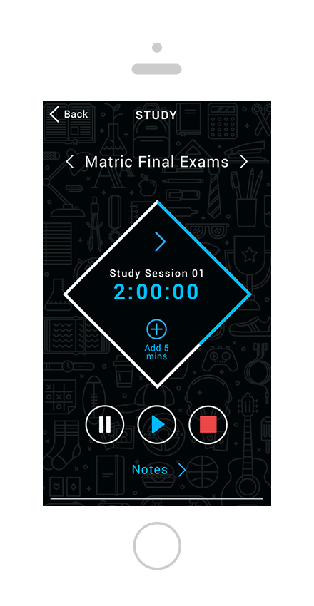
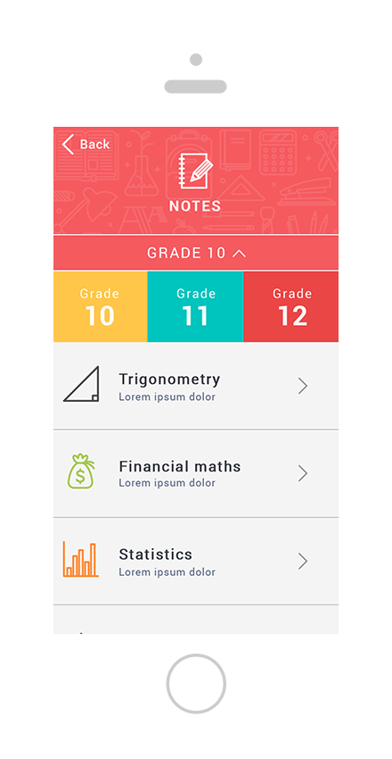
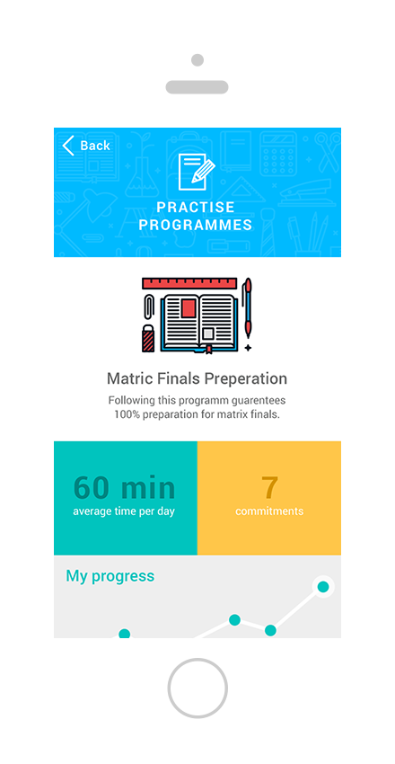
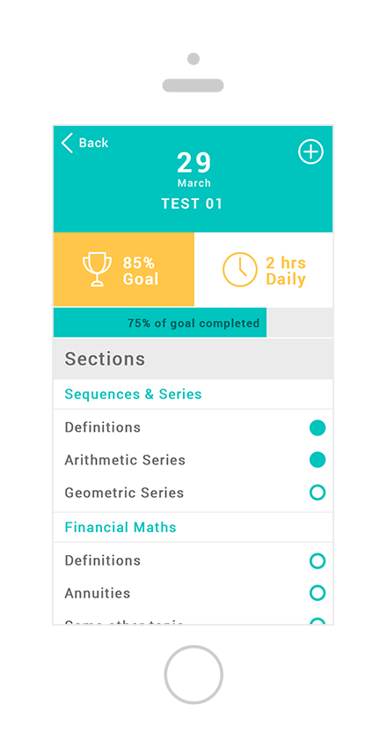

Slide 32
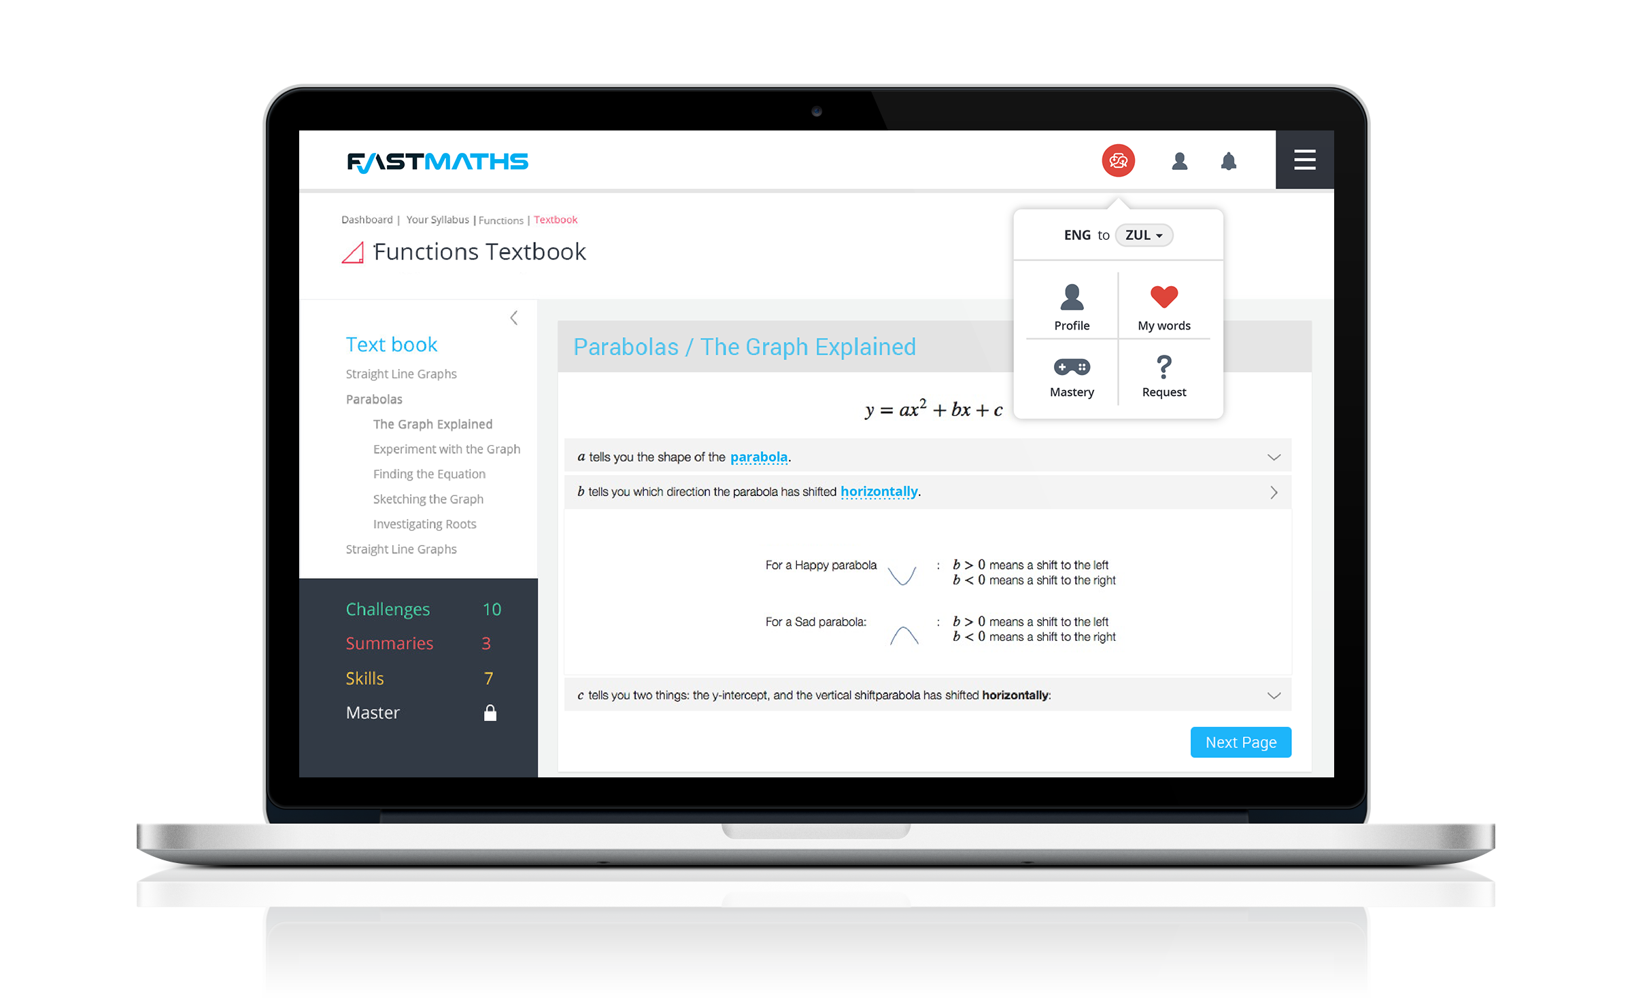

Slide 34
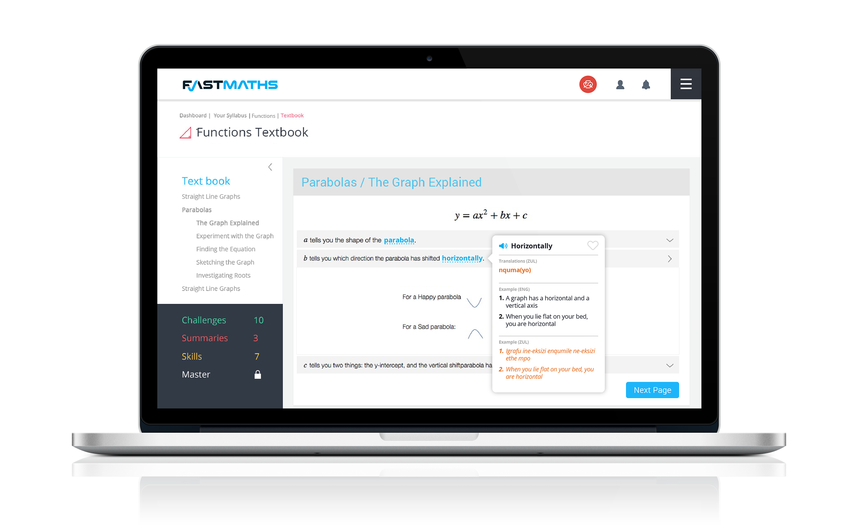

Slide 35
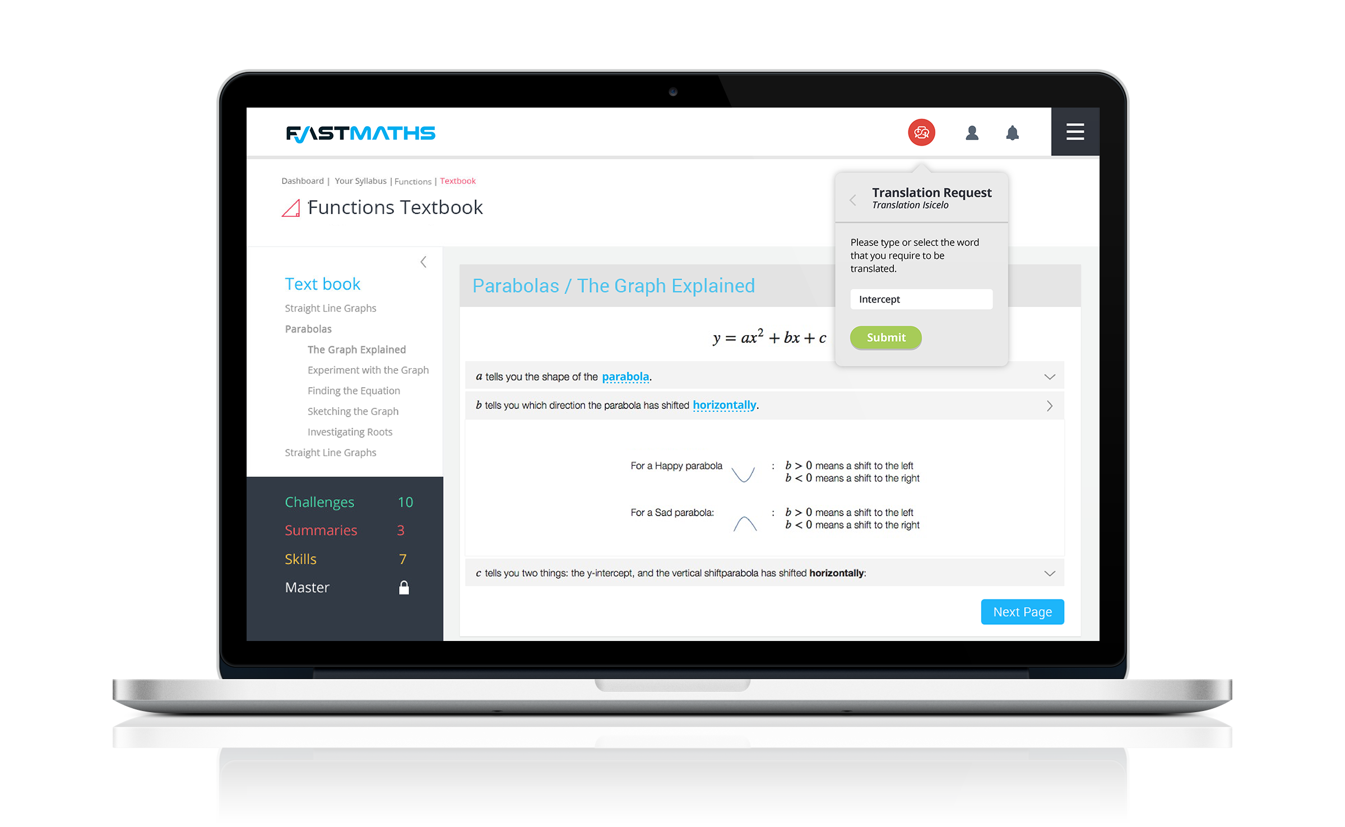

Slide 38
Let’s revisit Thandi
#OneNationOneConversation
Notes:
Thandi the rural school child (± 2.45m)
————————
Thandi is 12 years old and lives in [reigon, province].
[Description of province, most spoken language and metric passrate]. Thandi would like to become an engineer one day. [move this to when she’s older]
Up until grade 6 she is taught in her mother tongue, which is also the mother tongue of the teacher. Thandi is a smart child and under these circumstances Thandi excels, but when she reaches grade 7 the language she gets taught in, by SA Law, changes to english [insert contextual info relating to Eng in South Africa].
Although Thandi is very determined to excel at school, she now has to learn in a language that she is not very comfortable with, and to make matters worse her teacher is not much more comfortable with English than Thandi is.
This is where a big problem that we are facing in South Africa starts.
With Thandi’s lack of exposure to English and her teachers lack of experience teaching in english, she is might be able to move through the syllabus grasping around 40% of the content. As you imagine, this greatly impacts on her ability to excel. So what happens now? Well at the end of Thandi’s school career, if she was lucky enough to make it that far into her primary education, she has to write a national exam, which students at the vast majority of schools in South Africa also have to write.
Now for example in the mathematics paper, While a first language english speaking student in Cape Town understands a question and is busy focusing their time and energy on calculating the answer, Thandi focusing her time and energy on trying to understand what the actual is even asking her to do. In many cases she will answer incorrectly or eventually move on to the next question, with which she will very likely face the same problem. By the time that the exam writing period is over, she hasn’t even managed to finish all the answers as she was spending so much time trying to understand the questions, a task which is not accounted for by the educators who set the exams.
If you consider that this pattern is repeated throughout all the exams that Thandi writes, it becomes clear that Thandi would be considered lucky to pass her exams.

Slide 39
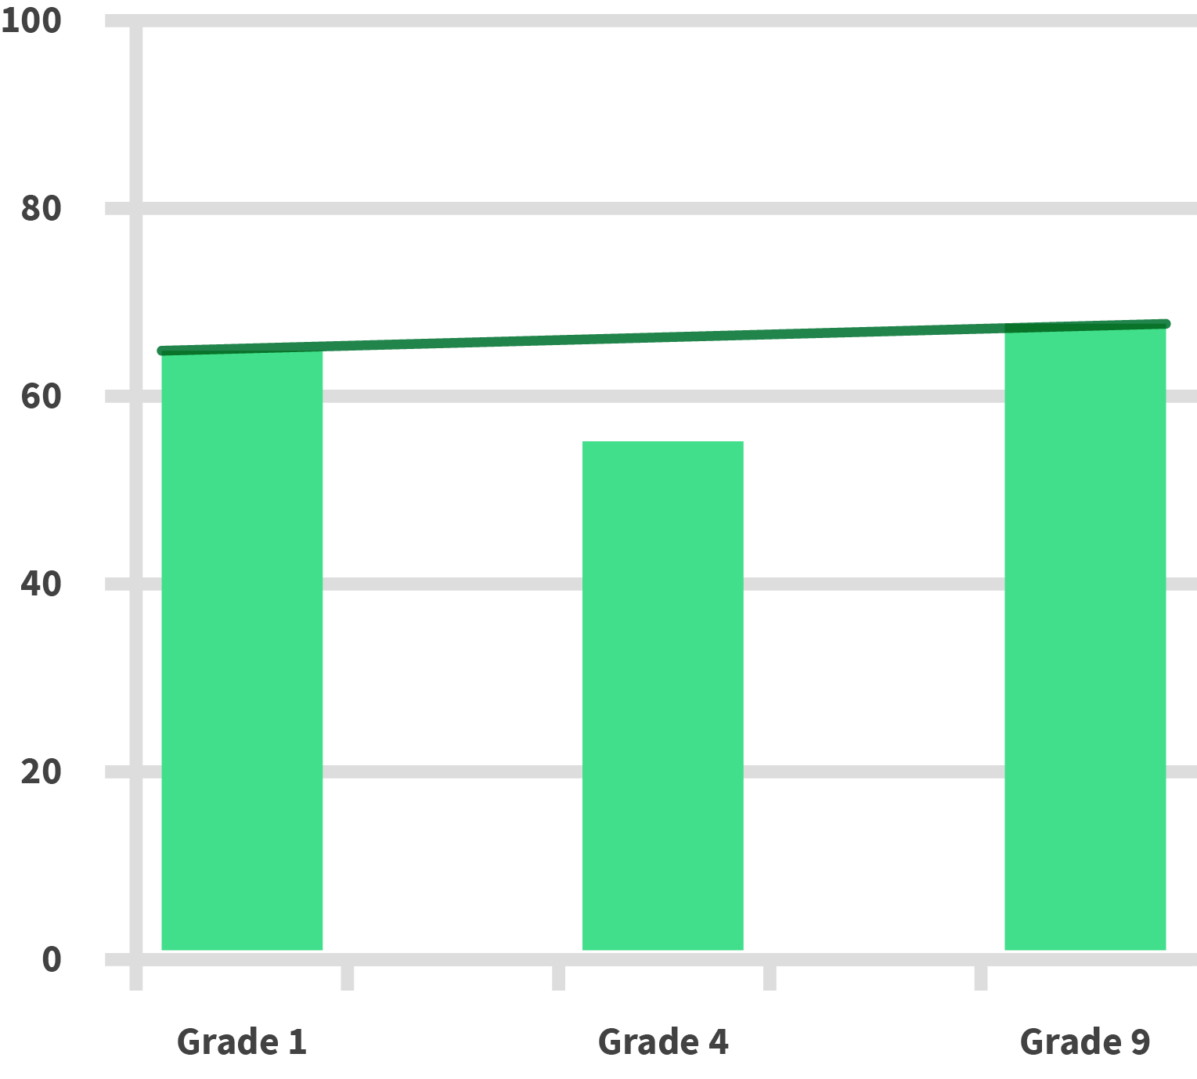
Mathematics average percentage marks
#OneNationOneConversation
Notes:
Thandi the rural school child (± 2.45m)
————————
Thandi is 12 years old and lives in [reigon, province].
[Description of province, most spoken language and metric passrate]. Thandi would like to become an engineer one day. [move this to when she’s older]
Up until grade 6 she is taught in her mother tongue, which is also the mother tongue of the teacher. Thandi is a smart child and under these circumstances Thandi excels, but when she reaches grade 7 the language she gets taught in, by SA Law, changes to english [insert contextual info relating to Eng in South Africa].
Although Thandi is very determined to excel at school, she now has to learn in a language that she is not very comfortable with, and to make matters worse her teacher is not much more comfortable with English than Thandi is.
This is where a big problem that we are facing in South Africa starts.
With Thandi’s lack of exposure to English and her teachers lack of experience teaching in english, she is might be able to move through the syllabus grasping around 40% of the content. As you imagine, this greatly impacts on her ability to excel. So what happens now? Well at the end of Thandi’s school career, if she was lucky enough to make it that far into her primary education, she has to write a national exam, which students at the vast majority of schools in South Africa also have to write.
Now for example in the mathematics paper, While a first language english speaking student in Cape Town understands a question and is busy focusing their time and energy on calculating the answer, Thandi focusing her time and energy on trying to understand what the actual is even asking her to do. In many cases she will answer incorrectly or eventually move on to the next question, with which she will very likely face the same problem. By the time that the exam writing period is over, she hasn’t even managed to finish all the answers as she was spending so much time trying to understand the questions, a task which is not accounted for by the educators who set the exams.
If you consider that this pattern is repeated throughout all the exams that Thandi writes, it becomes clear that Thandi would be considered lucky to pass her exams.

Slide 40
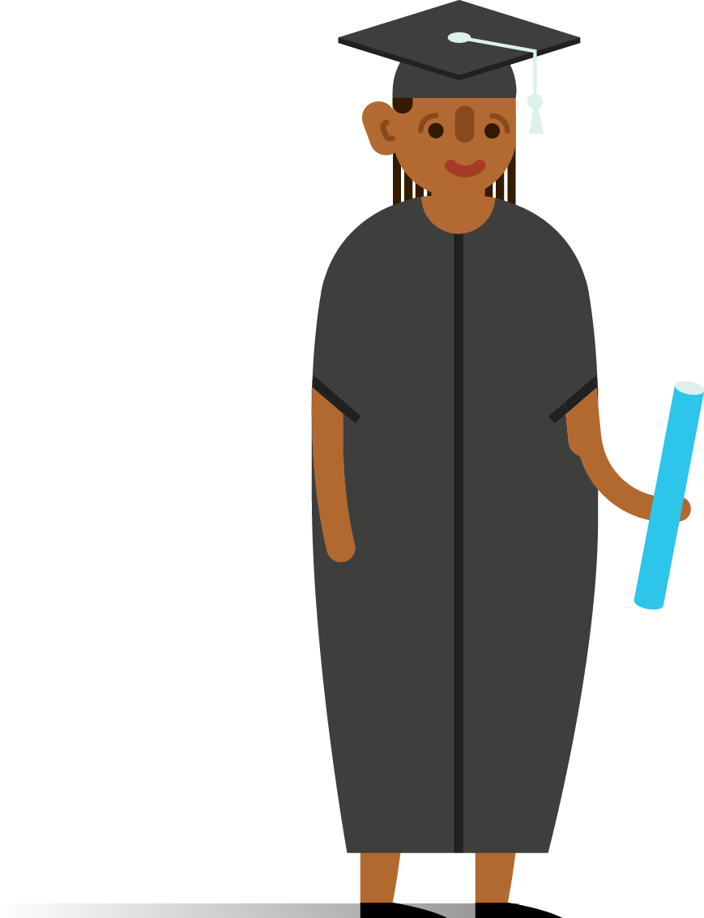
How is South Africa affected?

Slide 41
Social impact
of nationwide academic success
Social upliftment
Improved integration
Decreased crime

Slide 42
We invite everyone here and from anywhere in our global village to reach out to us with their ideas.
#OneNationOneConversation
Notes:
We invite everyone here and from anywhere in our global village to reach out to us and lets see how we can collaborate together… lets see how we can work together to uplift the world through breaking down language barriers and enabling progress and productivity.

Slide 43
Merci beaucoup! Ngicela ungiseze! Ndiyabulela! Ndo livhuwa nga maanda! Ke a leboga! Ndza khensa! Ngiyabonga! Ke a leboha! Ke lebogile kudu! Ngiyathokoza! Thank you! Baie dankie!
@aweza_app
/aweza.mobile
aweza.co.za

